Slide 1
Internet of Things Presentation
Fitbit Versa
ITP 447

Slide 2
Overview
What is it?
How do they help cases?
Where is data stored?
Acquisition?
Data available?
Vulnerabilities?
Frequency of updates?
Device security?

Slide 3
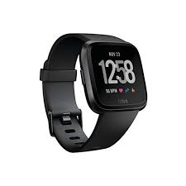
Fitbit Versa
Released April 2018
Fitness Tracker + Smartwatch
Heart Rate Monitor
Pedometer
Sleep Tracker
Notifications
Apps
Payment
GPS Data ONLY IF set to use connected smartphone’s GPS
Does not have its own internal GPS like other fitness trackers

Slide 4
FitBit Activity Trackers Overview
Wireless-enabled wearable devices that measure data such as heart rate, steps walked, track exercise, and GPS data
FitBit has sold more than 55 million devices world wide with a user base of 25 million
Online, mobile, and computer application to view data

Slide 5


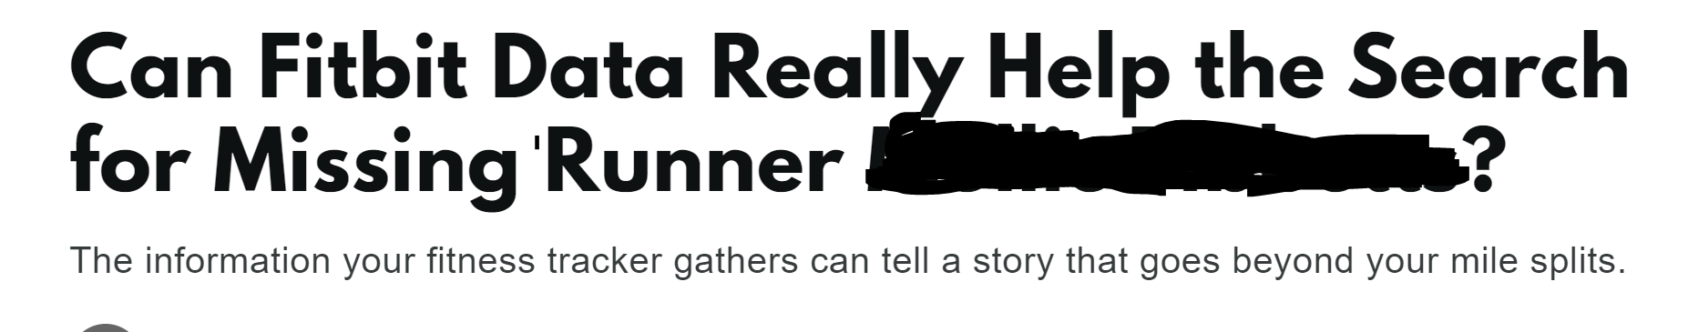
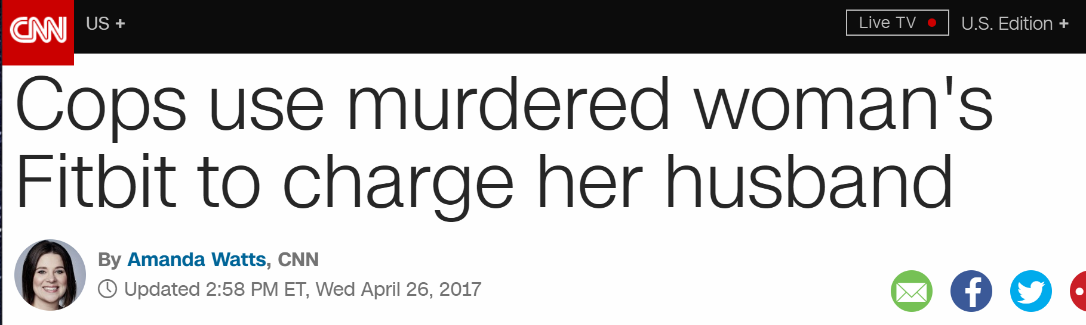
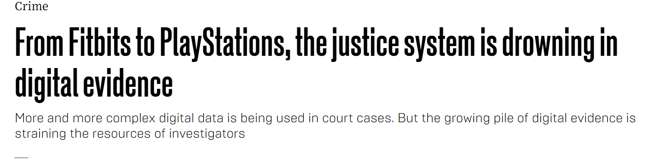
Media Portrayal

Slide 6
Caveat
There isn’t much accessible from the actual device
As with many wearable IoT devices, data is often sent to a connected handset or cloud accout
Custom operating system
Lack of actual cable connection

Slide 7
General ways to get data off an IoT device
Chip off/take the device apart
Network Traffic and Cloud Data
Direct from the device, whatever the File System/OS will allow you to access
From a connected Smartphone app

Slide 8
Data on the device?
https://dev.fitbit.com/build/guides/file-system/
The Versa does run with a file system which supports ASCII, UTF, JSON, and Binary
Each application has a private area of the device FS, files cannot be shared among applications
This data is irretrievable through cable connection
All interaction is via Bluetooth or Wi-Fi connection to the companion app

Slide 9
What can we get from interacting with the device?
MAC Address
Model
Version
FCC ID

Slide 10
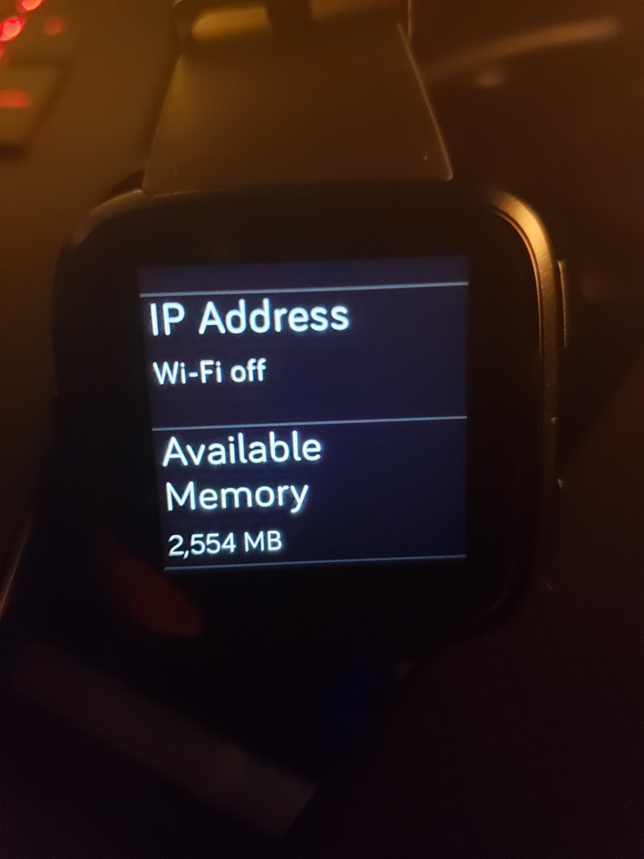
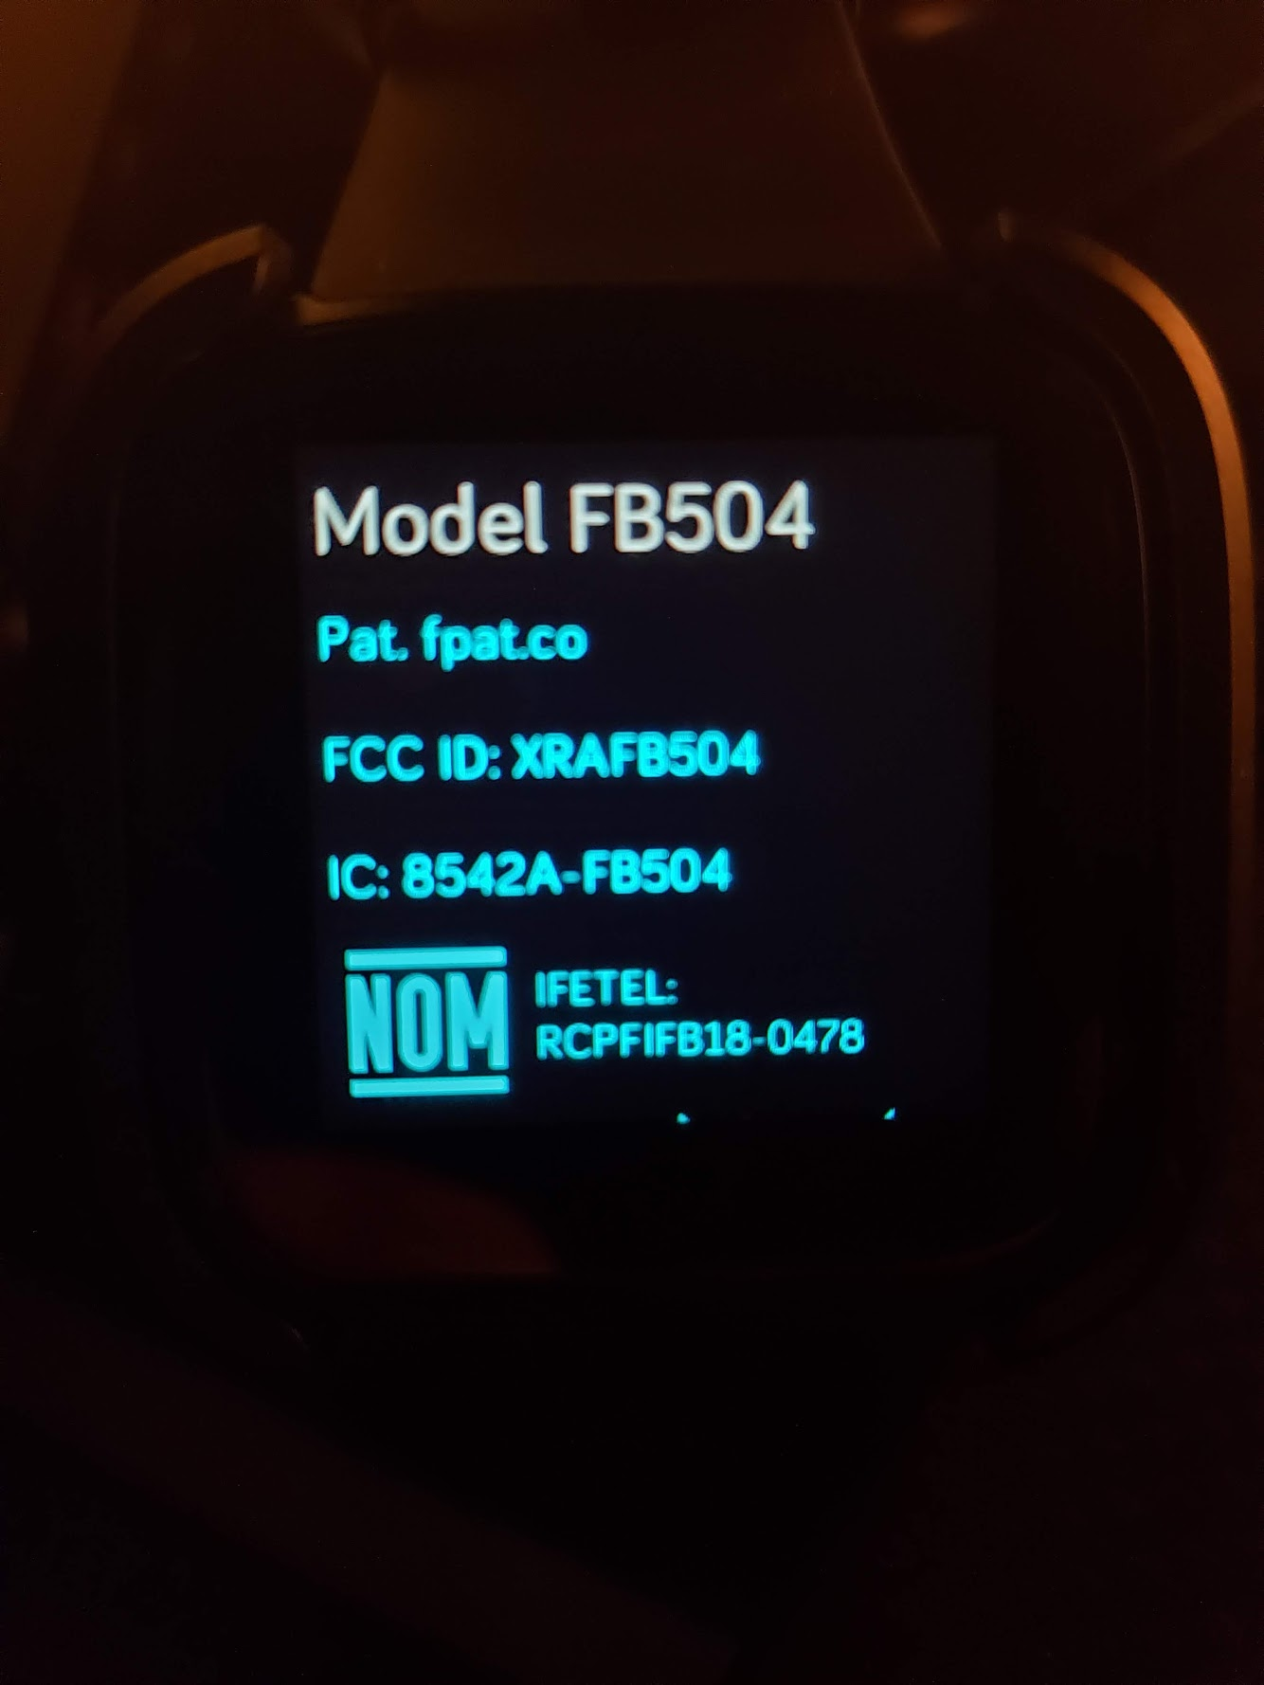
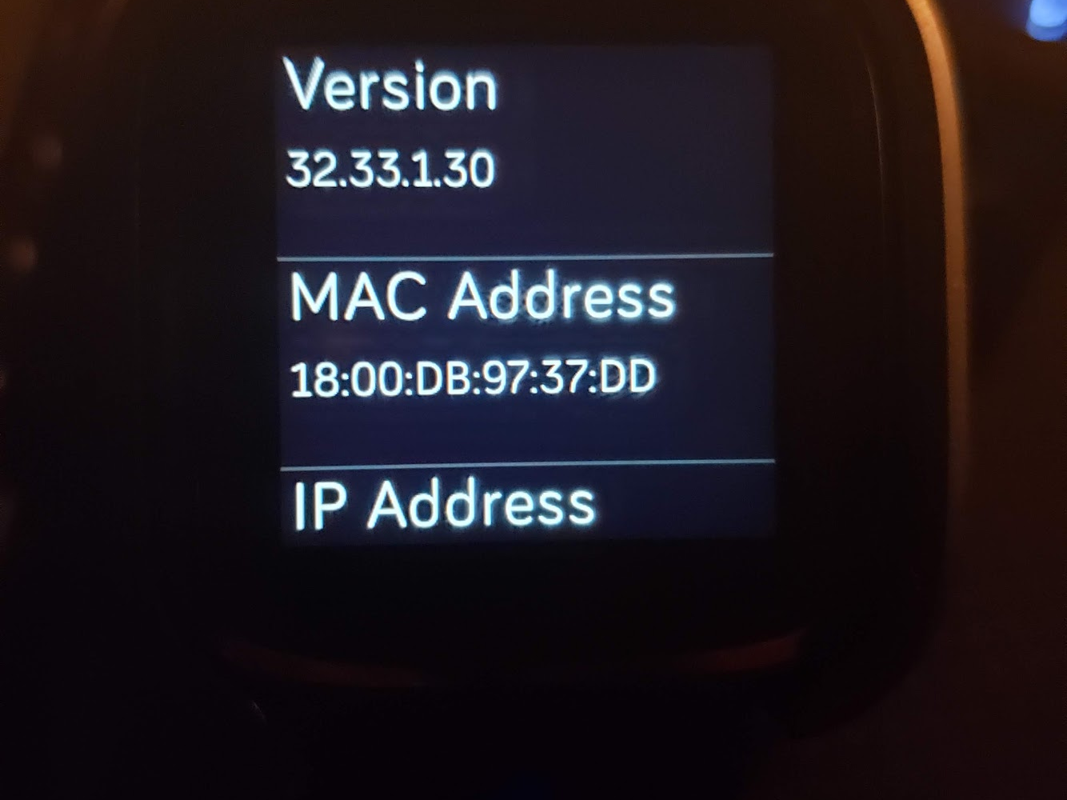

Slide 11
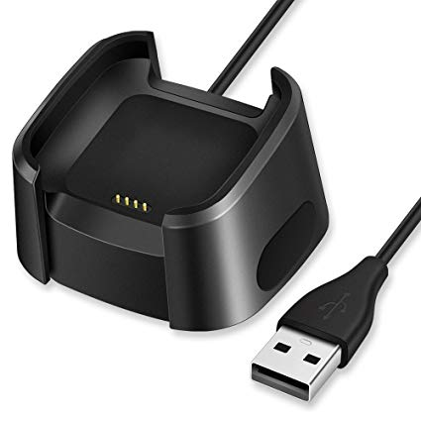
Interactions with Common Forensic Acquisition Tools
The Versa like its Fitbit cousins has its own custom charging port
The device when connected is private
You cannot directly access it
No device root currently exists
Nor is the device recognized when connected

Slide 12
Android Application Data
UFED 4PC
Logical extraction
File System extraction
Neither one had any hits for “fitbit” nor the application data associated with Fitbit
(Did not want to root my phone)
The application contains the same data as the Profile export and Cloud data
Notes:
Cellebrite Logical got nothing
Newest version supports Fitibit data

Slide 13
Cloud Data
UFED Cloud Analyzer
Web Capture supports the FitBit website for user data
Data on the website matches that on the Windows app and the smartphone app
Last Sync time
Public profile (includes join date)

Slide 14
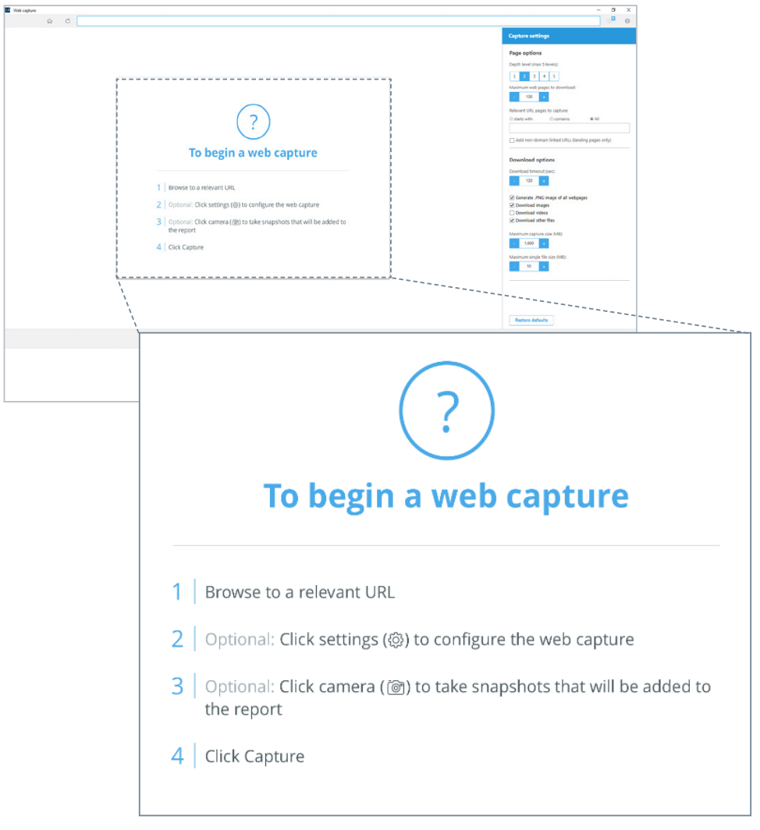
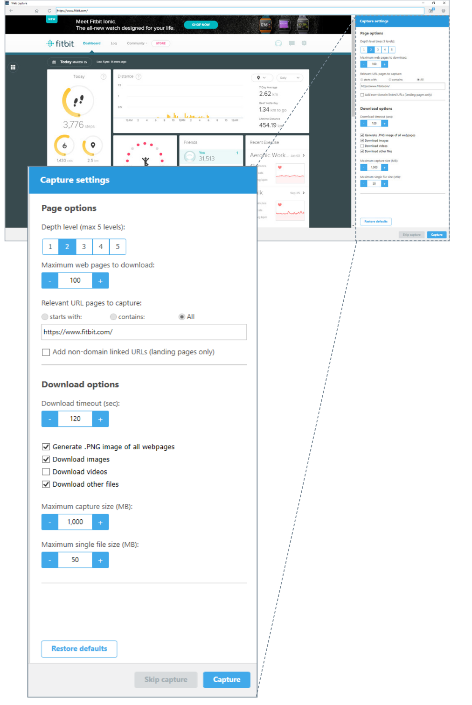
UFED Cloud Analyzer

Slide 15
Desktop Application (Win 10)
C:\Program Files\WindowsApps\Fitbit.Fitbit_<VERSION>_x64_\ contains the installation files
C:\Users\<USER>\AppData\Local\Packages\Fitbit.Fitbit\ contains application data
C\Users\<USER>\AppData\Local\Packages\Fitbit.Fitbit\LocalState\ contains SQLite files regarding the most recent session of the app

Slide 16
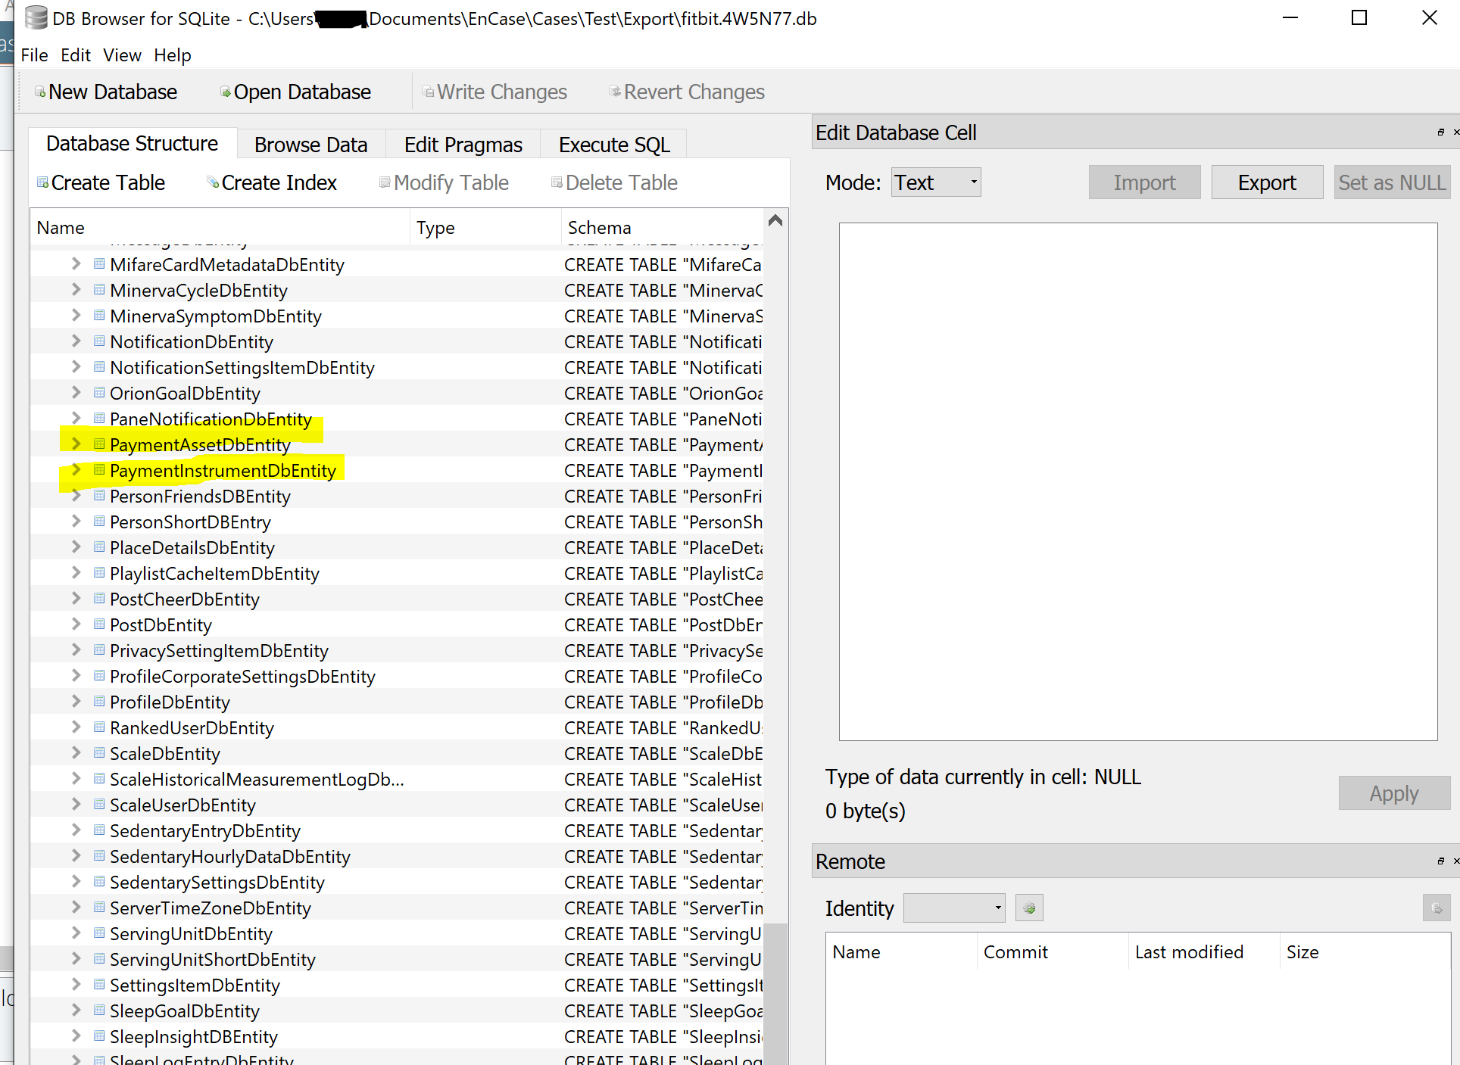
SQLite Instance Desktop App (Win 10)

Slide 17
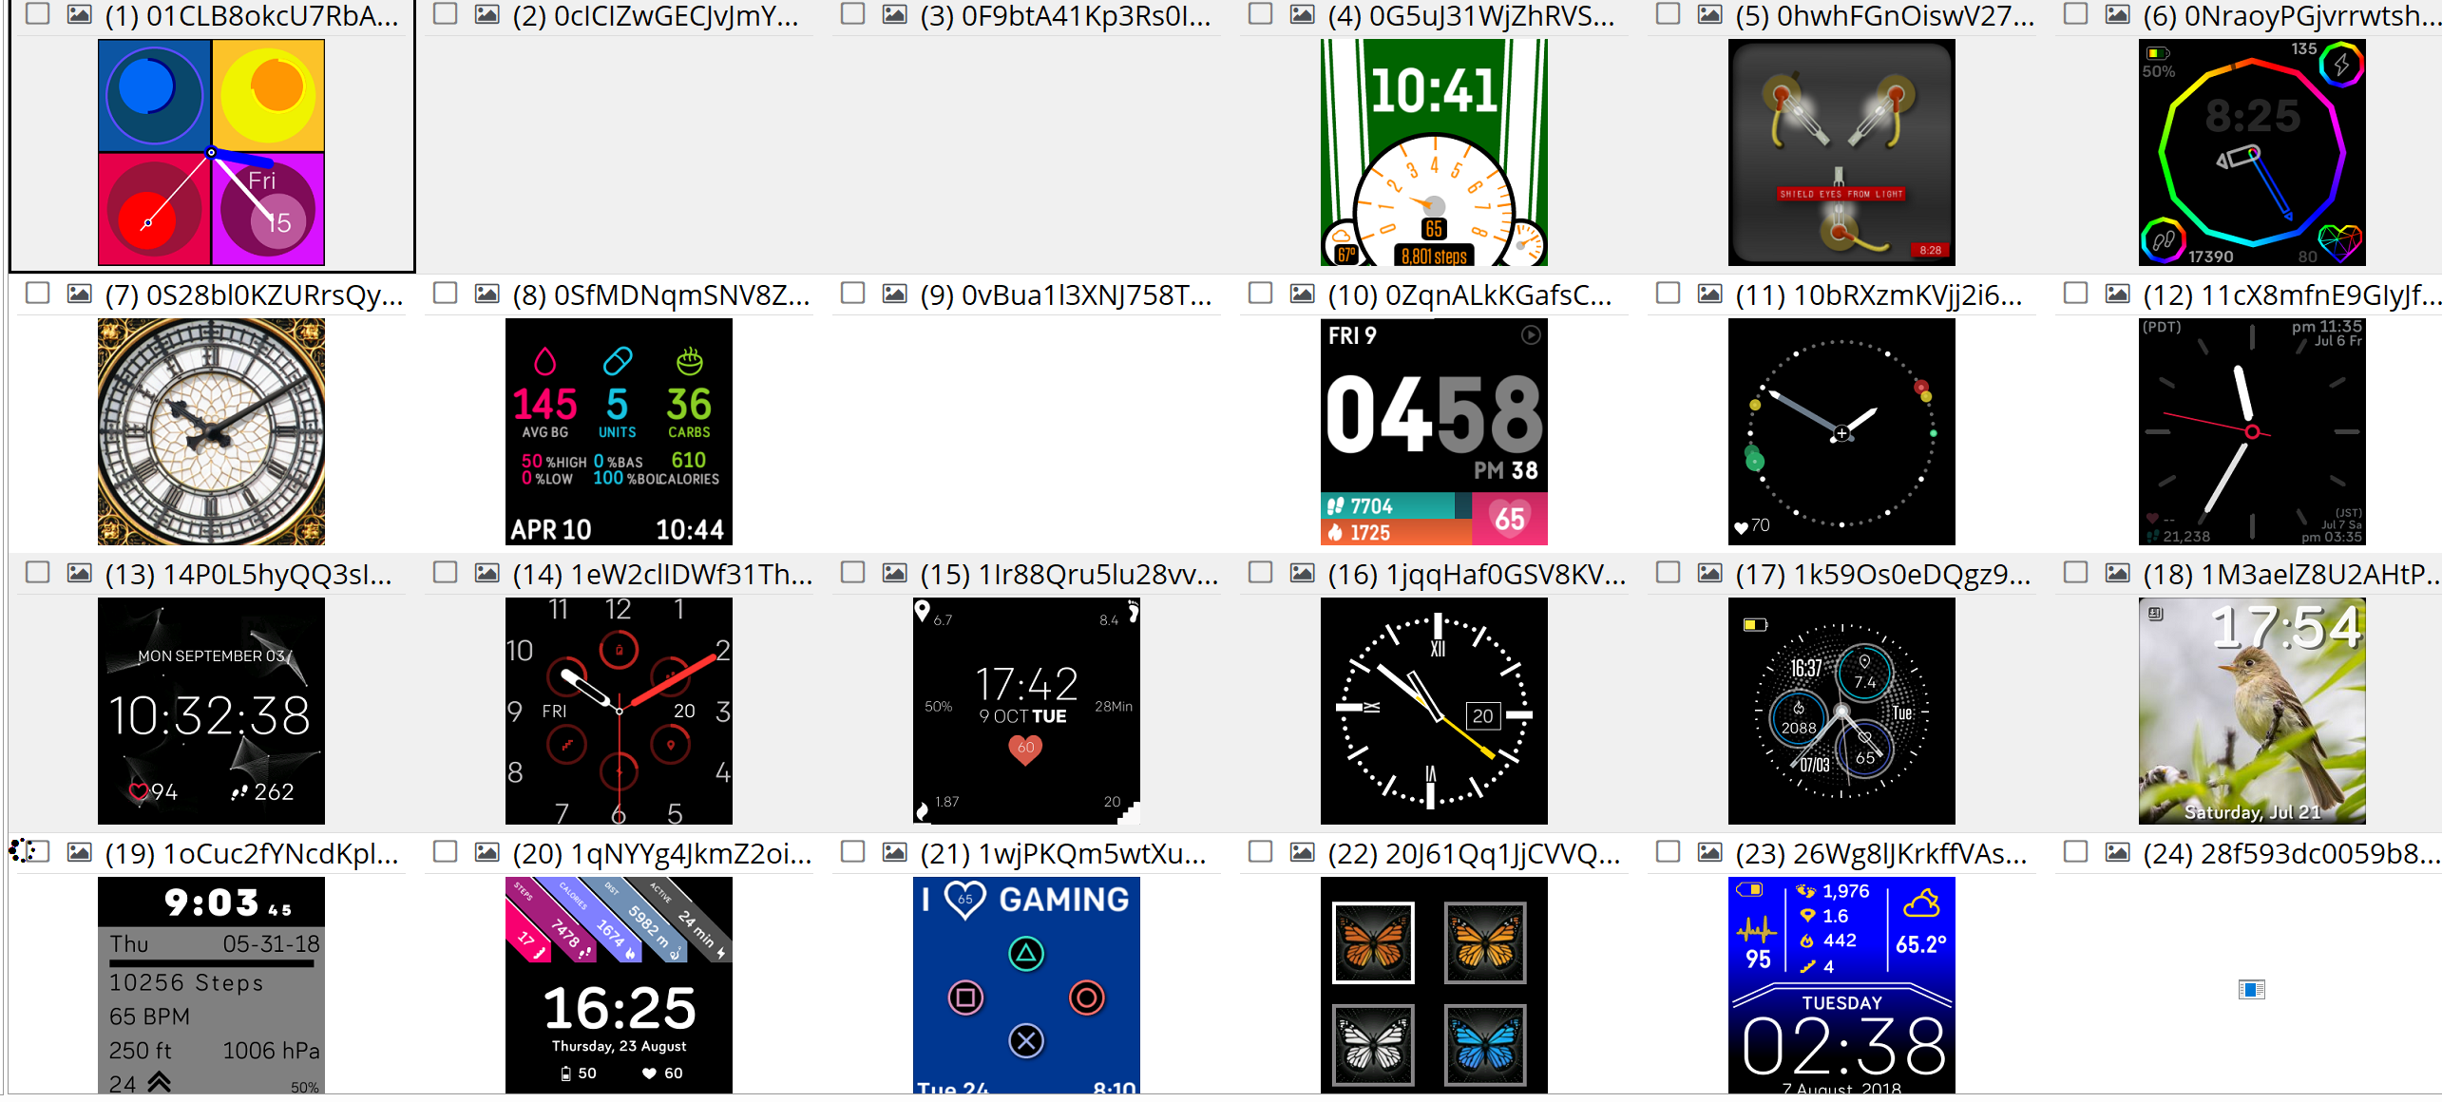
Recovered Cached Clock Faces

Slide 18
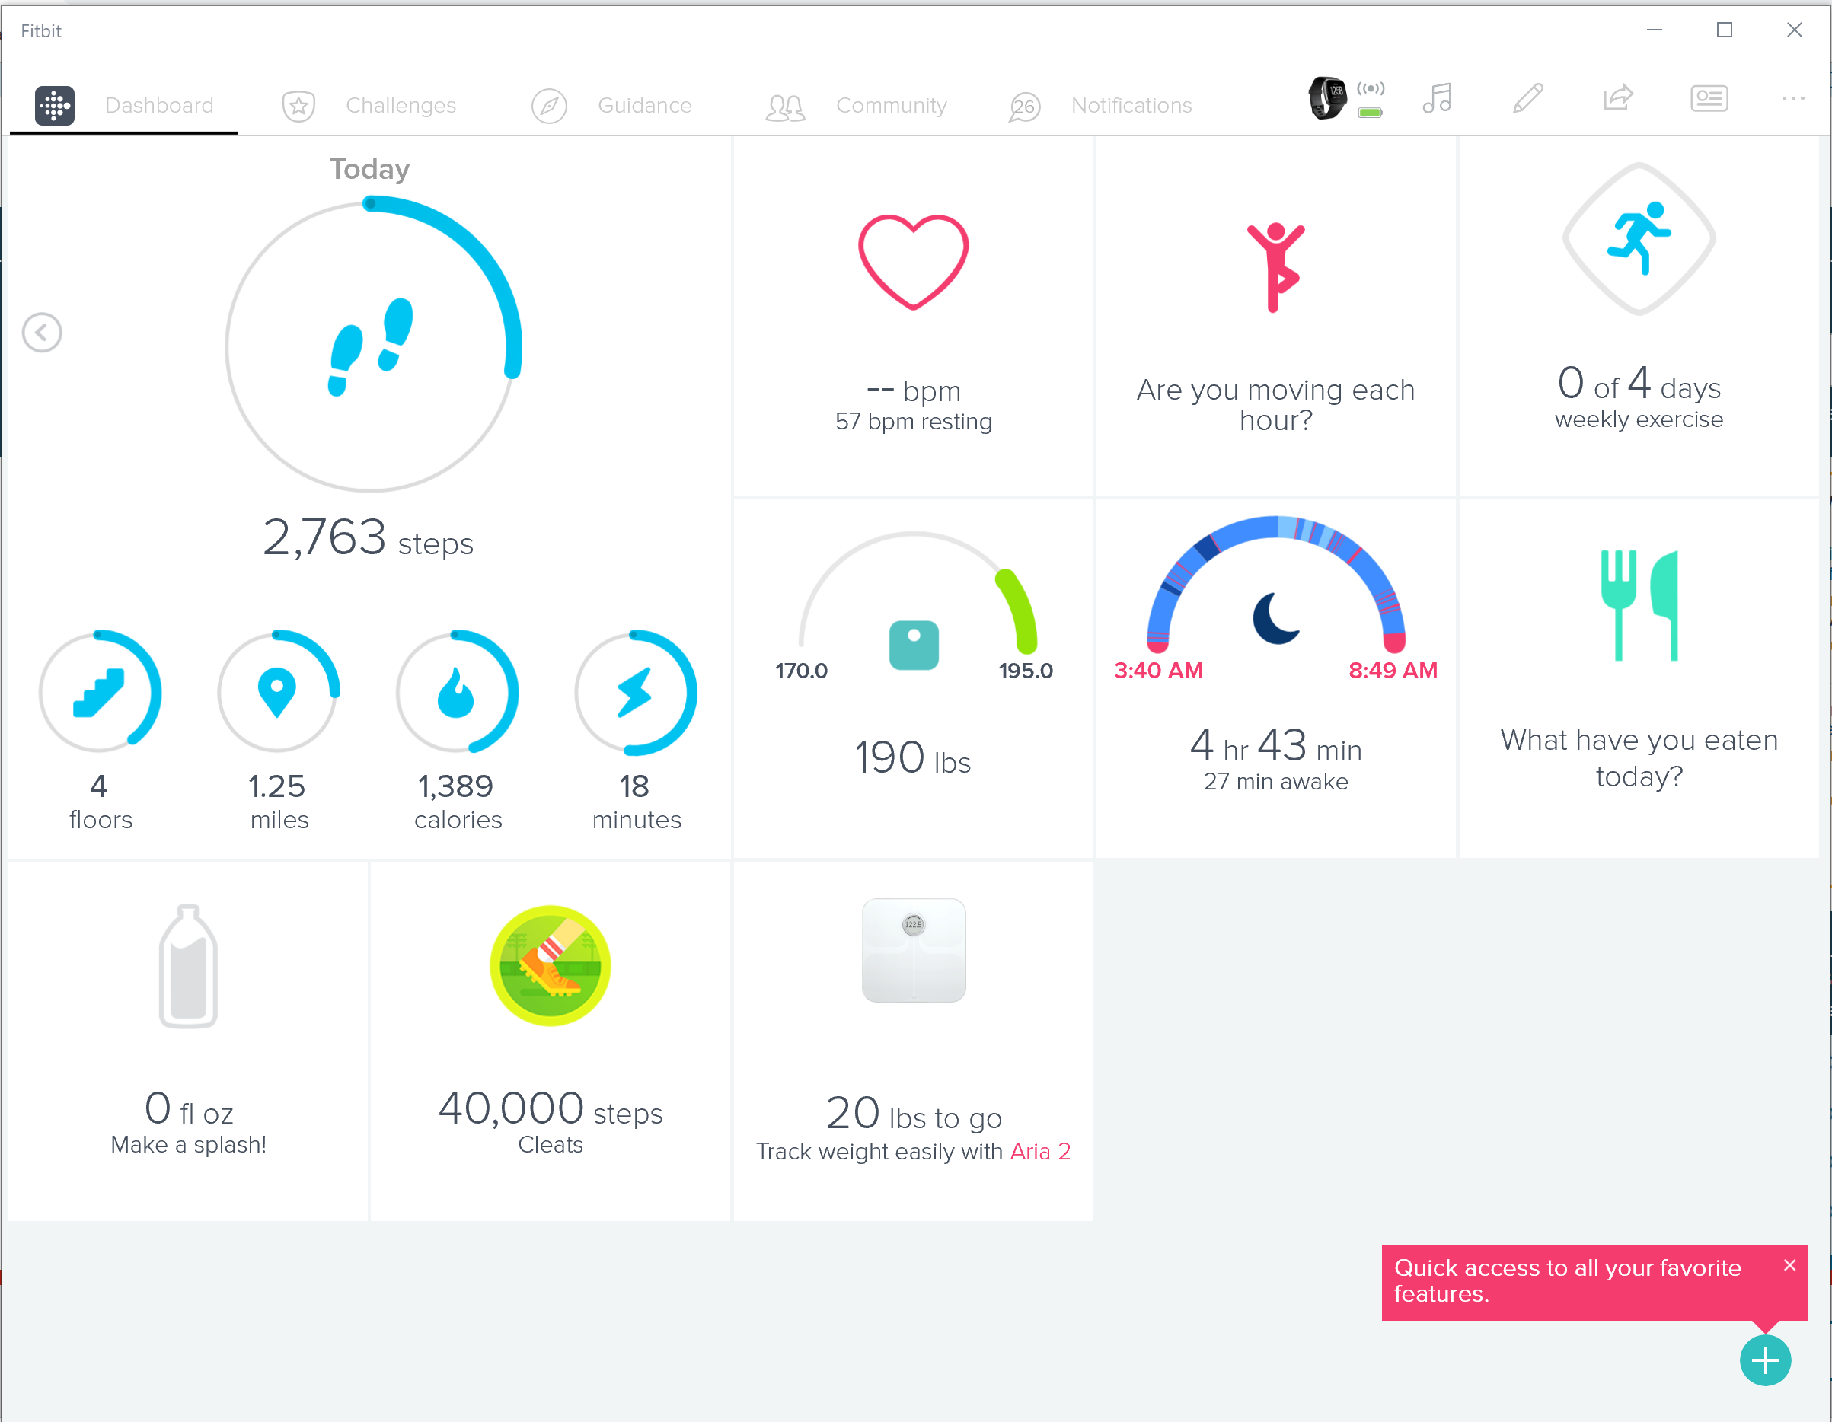
Desktop Application (Win 10)

Slide 19
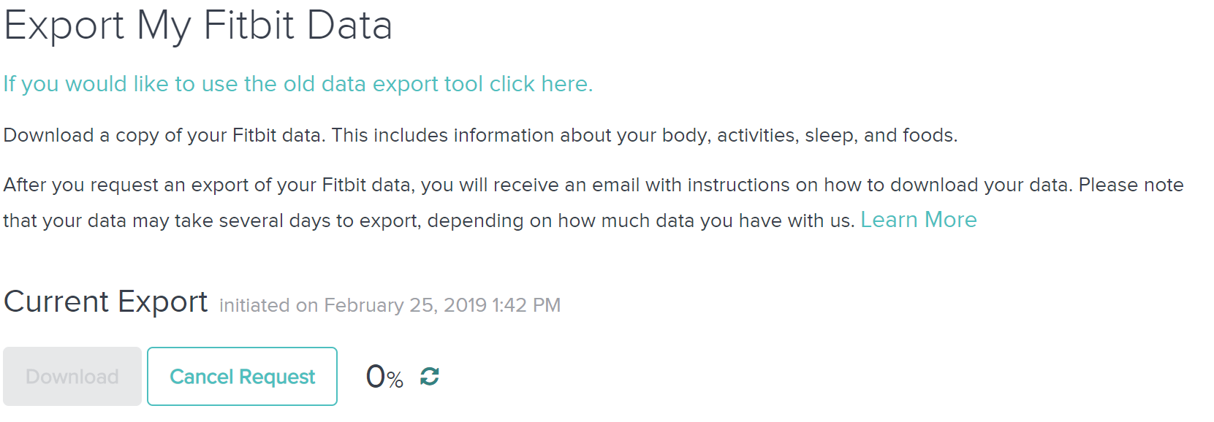
FitBit Website
Export the data if you have access to the account
https://www.fitbit.com/settings/data/export
Importable into other data viewers

Slide 20
Known Vulnerabilities
None publicly available regarding the Versa specifically
http://homepages.inf.ed.ac.uk/ppatras/pub/imwut18.pdf
Older paper from 2016 detailing the Fitbit communication protocol and potential methods to extract user data

Slide 21
Frequency of Updates + Support
Infrequent major version updates
Firmware, software updates and features are not pre-announced
Smaller updates commonly pushed out
Last update was today 2/25

Slide 22
Device Security
Bug Bounty program https://bugcrowd.com/fitbit
Uses end-to-end encryption since 2016
Vulnerable to interceptions of Bluetooth transmissions
Each “app” has their own private area in the device file system, files cannot be shared amongst different applications

Slide 23
Fitbit Security Concerns
Data Leak -> Blackmail
Say you’re not as active as you are
“This guy does indeed not lyft”
GPS data
“other nefarious purposes”
Malware
Potentially malicious app on the new Fitbit App store which can communicate back to the device

Slide 24
Future Work
Use Wireshark to monitor activity and data communicated between Fitbit device and Smartphone
“Chip-off” the device?

